Slide 1
Homework #4 Discussion
2.24 – Bases
2.40 – BFS
3.1 – Representation Theorem

Slide 2
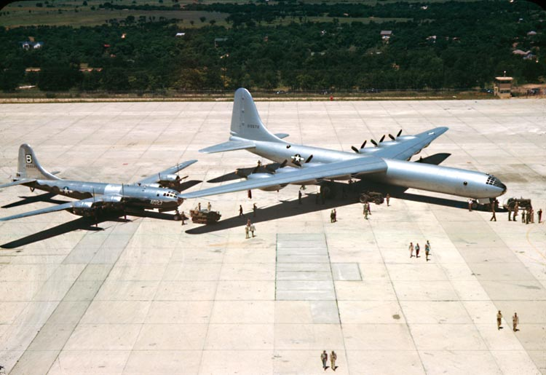


Slide 3
OPER 610 Lesson 07 Initialization Methods, Degeneracy, Cycling, and Stalling
Dr Brian J. Lunday
Office: Rm 201E, Bldg 641

Slide 4
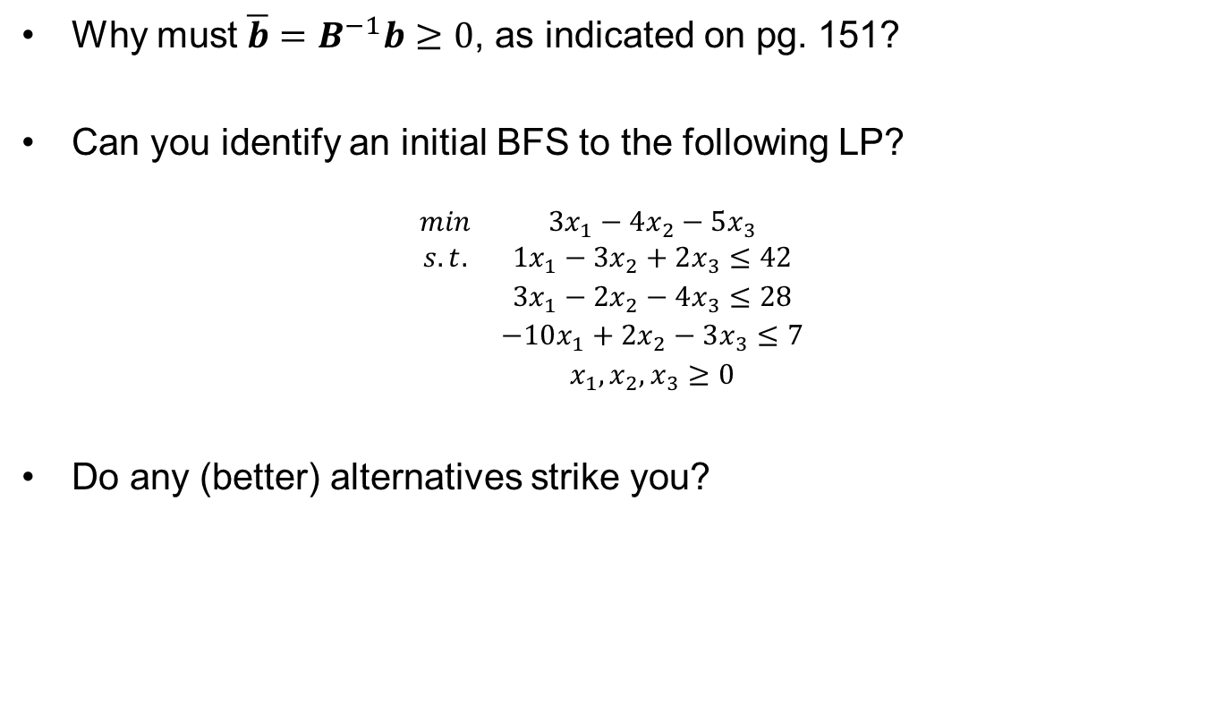
Initialization Method #1 Initial BFS by Inspection
Why must $\overline{b}=B^{−1}b≥0$, as indicated on pg. 151?
Can you identify an initial BFS to the following LP?
$$\begin{matrix}min & 3x_{1}−4x_{2}−5x_{3} \\ s.t. & 1x_{1}−3x_{2}+2x_{3}≤42 \\ & 3x_{1}−2x_{2}−4x_{3}≤28 \\ & −10x_{1}+2x_{2}−3x_{3}≤7 \\ & x_{1},x_{2},x_{3}≥0\end{matrix}$$
Do any (better) alternatives strike you?

Slide 5
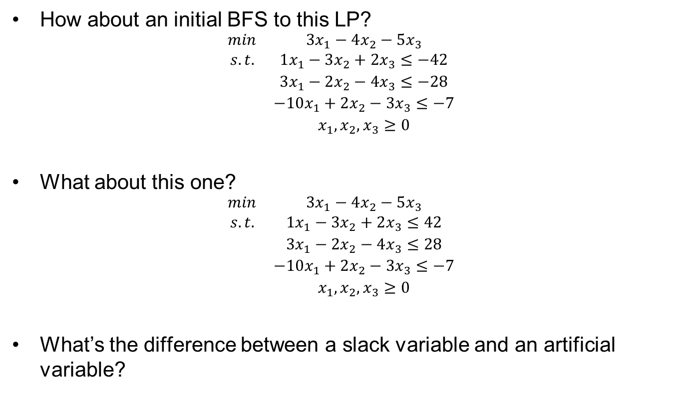
Initialization Method #1 No Initial BFS by Inspection
How about an initial BFS to this LP?
$$\begin{matrix}min & 3x_{1}−4x_{2}−5x_{3} \\ s.t. & 1x_{1}−3x_{2}+2x_{3}≤−42 \\ & 3x_{1}−2x_{2}−4x_{3}≤−28 \\ & −10x_{1}+2x_{2}−3x_{3}≤−7 \\ & x_{1},x_{2},x_{3}≥0\end{matrix}$$
What about this one?
$$\begin{matrix}min & 3x_{1}−4x_{2}−5x_{3} \\ s.t. & 1x_{1}−3x_{2}+2x_{3}≤42 \\ & 3x_{1}−2x_{2}−4x_{3}≤28 \\ & −10x_{1}+2x_{2}−3x_{3}≤−7 \\ & x_{1},x_{2},x_{3}≥0\end{matrix}$$
What’s the difference between a slack variable and an artificial variable?

Slide 6
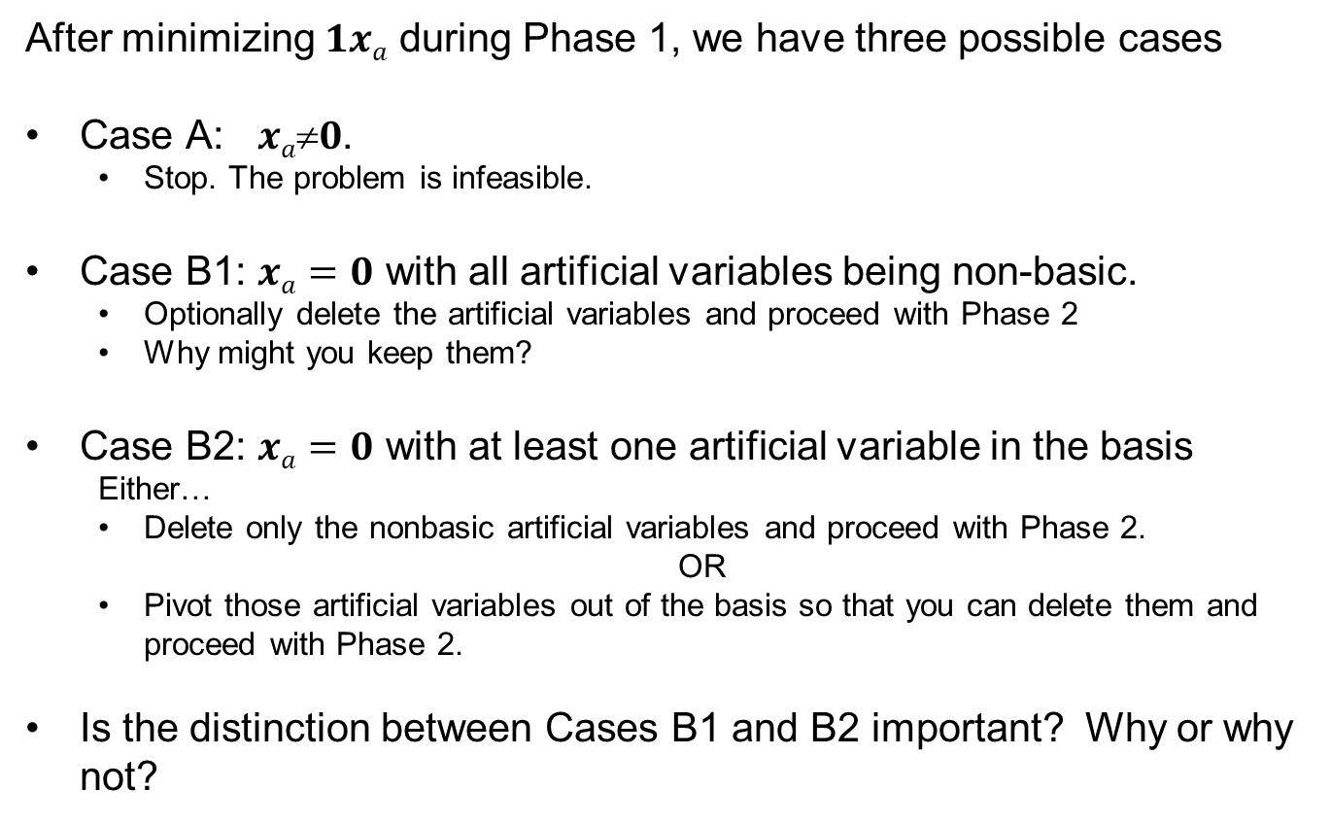
Initialization Method #2 Two Phase Method
After minimizing $1xa$ during Phase 1, we have three possible cases
Case A: $xa0$.
Stop. The problem is infeasible.
Case B1: $xa=0$ with all artificial variables being non-basic.
Optionally delete the artificial variables and proceed with Phase 2
Why might you keep them?
Case B2: $xa=0$ with at least one artificial variable in the basis
Either…
Delete only the nonbasic artificial variables and proceed with Phase 2.
OR
Pivot those artificial variables out of the basis so that you can delete them and proceed with Phase 2.
Is the distinction between Cases B1 and B2 important? Why or why not?

Slide 7


Initialization Method #3 Big-$M$ Method
Are the two-phases described by the authors necessary? Why or why not?
Are the two-phases described by the authors helpful? If so, how?
How big should $M$ be?

Slide 8
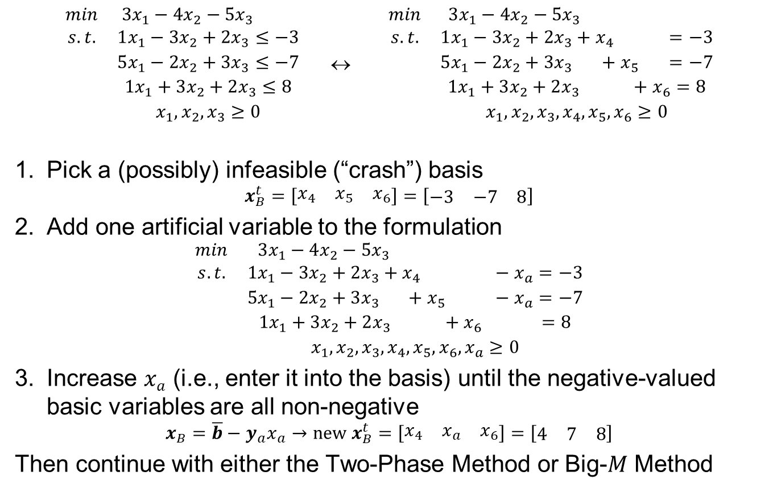
Initialization Method #4 Single Artificial Variable Technique
$\begin{matrix}min & 3x_{1}−4x_{2}−5x_{3} \\ s.t. & 1x_{1}−3x_{2}+2x_{3}≤−3 \\ & 5x_{1}−2x_{2}+3x_{3}≤−7 \\ & 1x_{1}+3x_{2}+2x_{3}≤8 \\ & x_{1},x_{2},x_{3}≥0\end{matrix}$ ↔ $\begin{matrix}min & 3x_{1}−4x_{2}−5x_{3} \\ s.t. & 1x_{1}−3x_{2}+2x_{3}+x_{4} =−3 \\ & 5x_{1}−2x_{2}+3x_{3} +x_{5} =−7 \\ & 1x_{1}+3x_{2}+2x_{3} +x_{6}=8 \\ & x_{1},x_{2},x_{3},x_{4},x_{5},x_{6}≥0\end{matrix}$
Pick a (possibly) infeasible (“crash”) basis
$$x_{B}^{t}=\left[\begin{matrix}x_{4} & x_{5} & x_{6}\end{matrix}\right]=\left[\begin{matrix}−3 & −7 & 8\end{matrix}\right]$$
Add one artificial variable to the formulation
$$\begin{matrix}min & 3x_{1}−4x_{2}−5x_{3} \\ s.t. & 1x_{1}−3x_{2}+2x_{3}+x_{4} −x_{a}=−3 \\ & 5x_{1}−2x_{2}+3x_{3} +x_{5} −x_{a}=−7 \\ & 1x_{1}+3x_{2}+2x_{3} +x_{6} =8 \\ & x_{1},x_{2},x_{3},x_{4},x_{5},x_{6},x_{a}≥0\end{matrix}$$
Increase $xa$ (i.e., enter it into the basis) until the negative-valued basic variables are all non-negative
$$x_{B}=\overline{b}−y_{a}x_{a}→new x_{B}^{t}=\left[\begin{matrix}x_{4} & x_{a} & x_{6}\end{matrix}\right]=\left[\begin{matrix}4 & 7 & 8\end{matrix}\right]$$
Then continue with either the Two-Phase Method or Big-$M$ Method

Slide 9
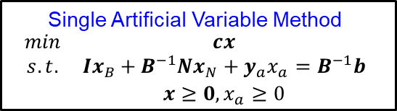





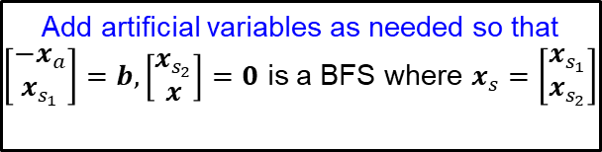
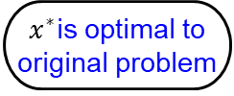


Initialization Options Putting It All Together
Identify a BFS
Is $x_{s}=b$
a BFS?
$$\begin{matrix}min & cx \\ s.t. & Ax≤b \\ & x≥0\end{matrix}$$
Add slack variables $x_{s}$
$$\begin{matrix}min & cx \\ s.t. & Ax=b \\ & x≥0\end{matrix}$$
YES
NO
Add artificial variables as needed so that
$\left[\begin{matrix}{−x}_{a} \\ x_{s_{1}}\end{matrix}\right]=b,\left[\begin{matrix}x_{s_{2}} \\ x\end{matrix}\right]=0$ is a BFS where $x_{s}=\left[\begin{matrix}x_{s_{1}} \\ x_{s_{2}}\end{matrix}\right]$
Single Artificial Variable Method
$$\begin{matrix}min & cx \\ s.t. & Ix_{B}+B^{−1}Nx_{N}+y_{a}x_{a}=B^{−1}b \\ & x≥0, x_{a}≥0\end{matrix}$$
Big-$M$ Method
$$\begin{matrix}min & cx+M1x_{a} \\ s.t. & Ax+x_{a}=b \\ & x,x_{a}≥0\end{matrix}$$
Two Phase Method
$$\begin{matrix}min & 1x_{a} \\ s.t. & Ax+x_{a}=b \\ & x,x_{a}≥0\end{matrix}$$
Eliminating artificial variables from the basis
Solve the original problem
YES
Is $x_{a}=0$?
Is $x_{a}=0$?
YES
NO
NO
$x^{∗}$is optimal to original problem
LP is infeasible
Remove artificial variables

Slide 10
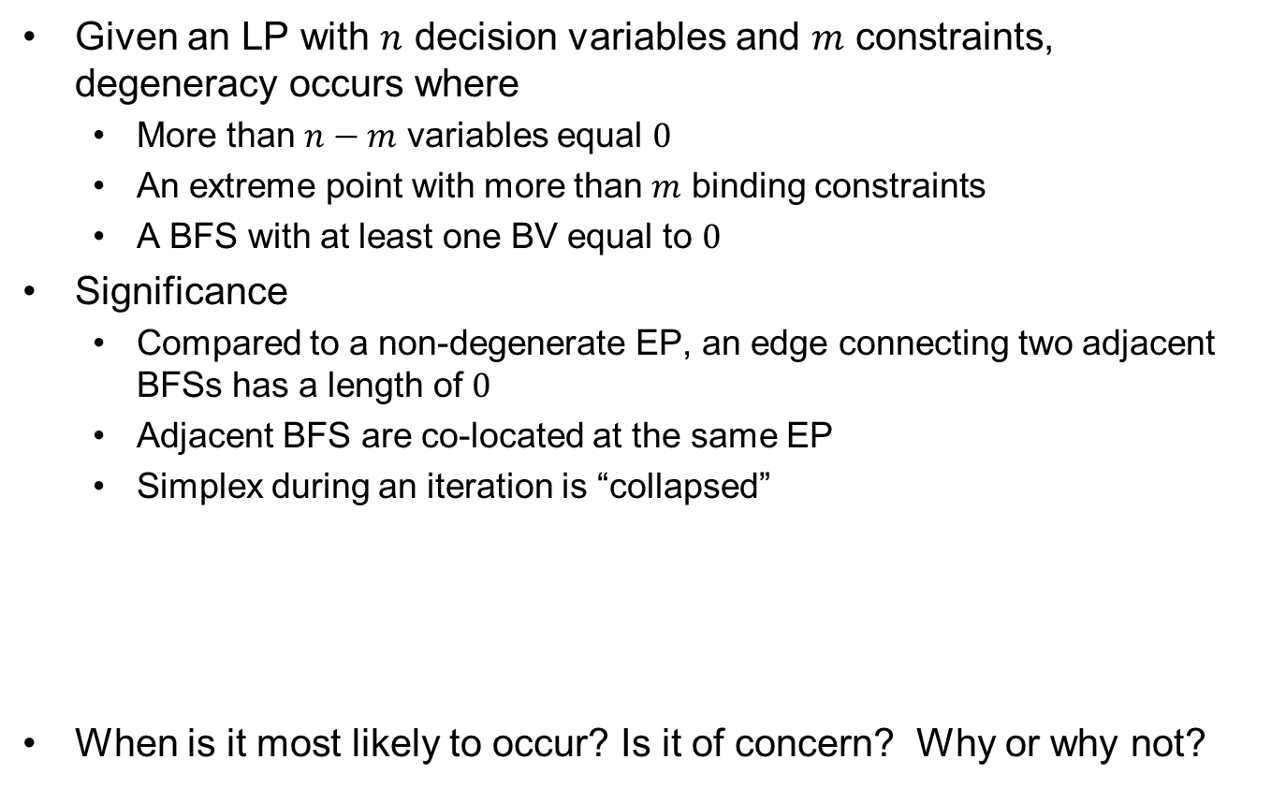
On Degeneracy and Degenerate Basic Feasible Solutions
Given an LP with $n$ decision variables and $m$ constraints, degeneracy occurs where
More than $n−m$ variables equal $0$
An extreme point with more than $m$ binding constraints
A BFS with at least one BV equal to $0$
Significance
Compared to a non-degenerate EP, an edge connecting two adjacent BFSs has a length of $0$
Adjacent BFS are co-located at the same EP
Simplex during an iteration is “collapsed”
When is it most likely to occur? Is it of concern? Why or why not?

Slide 11
Degeneracy & Cycling
Degenerate pivot
Changes the BFS while remaining at the same EP
Cycling
A repeating sequence of degenerate pivots
Only occurs for degenerate problems
First example: Hoffman (1953) using trig functions
Can avoid w/certain rules for entering/exiting variable
Stalling
A non-repeating (finite) sequence of degenerate pivots
Only occurs for degenerate problems
Can avoid w/certain rules for entering/exiting variable

Slide 12
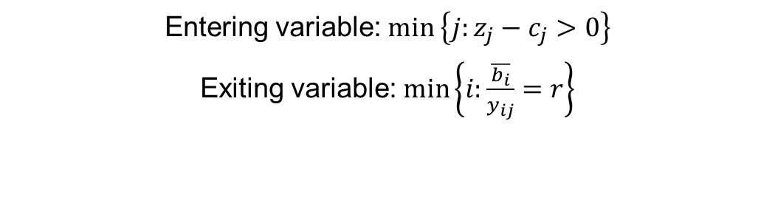
Cycling Prevention Rule #1 Bland’s Rule
Entering variable: $\min\left\{j:z_{j}−c_{j}>0\right\}$
Exiting variable: $\min\left\{i:\frac{\overline{b_{i}}}{y_{ij}}=r\right\}$

Slide 13
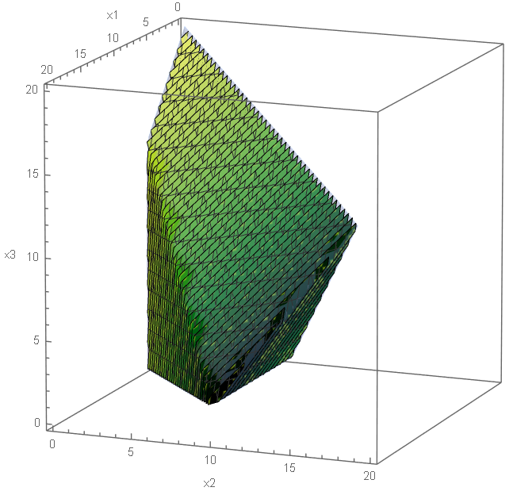
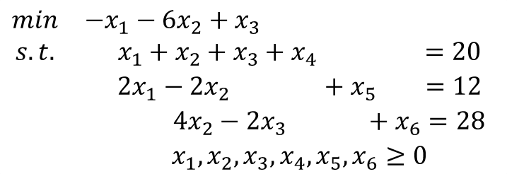
Simplex Algorithm with Bland’s Rule to Prevent Cycling (Initialization)
Problem P
$$\begin{matrix}min & −x_{1}−6x_{2}+x_{3} \\ s.t. & x_{1}+x_{2}+x_{3}+x_{4} =20 \\ & 2x_{1}−2x_{2} +x_{5} =12 \\ & 4x_{2}−2x_{3} +x_{6}=28 \\ & x_{1},x_{2},x_{3},x_{4},x_{5},x_{6}≥0\end{matrix}$$
INTIALIZATION STEP
$$B=\left[\begin{matrix}a_{4} & a_{5} & a_{6}\end{matrix}\right]=\left[\begin{matrix}1 & 0 & 0 \\ 0 & 1 & 0 \\ 0 & 0 & 1\end{matrix}\right]$$
Degenerate EP

Slide 14
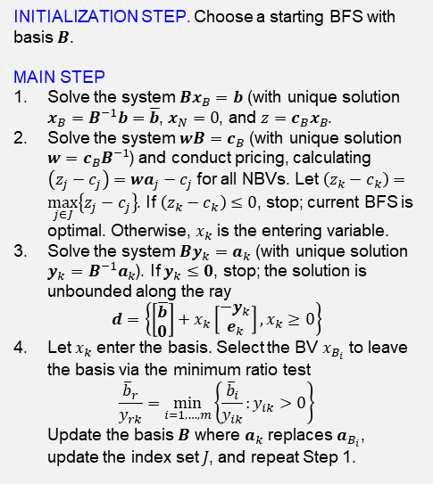
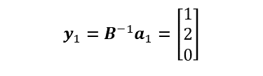
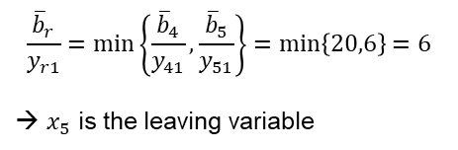
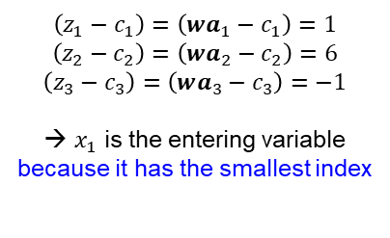
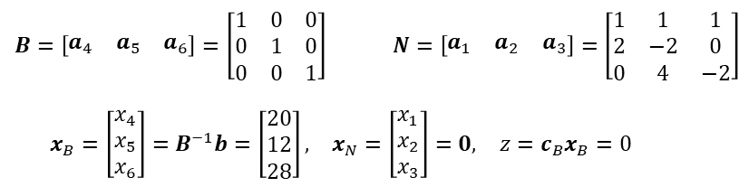
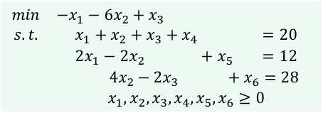
Simplex Algorithm with Bland’s Rule to Prevent Cycling (Iteration #1)
Step 1
$$\begin{matrix}min & −x_{1}−6x_{2}+x_{3} \\ s.t. & x_{1}+x_{2}+x_{3}+x_{4} =20 \\ & 2x_{1}−2x_{2} +x_{5} =12 \\ & 4x_{2}−2x_{3} +x_{6}=28 \\ & x_{1},x_{2},x_{3},x_{4},x_{5},x_{6}≥0\end{matrix}$$
$$\begin{matrix}B=\left[\begin{matrix}a_{4} & a_{5} & a_{6}\end{matrix}\right]=\left[\begin{matrix}1 & 0 & 0 \\ 0 & 1 & 0 \\ 0 & 0 & 1\end{matrix}\right] & & N=\left[\begin{matrix}a_{1} & a_{2} & a_{3}\end{matrix}\right]=\left[\begin{matrix}1 & 1 & 1 \\ 2 & −2 & 0 \\ 0 & 4 & −2\end{matrix}\right]\end{matrix}$$
$$\begin{matrix}x_{B}=\left[\begin{matrix}x_{4} \\ x_{5} \\ x_{6}\end{matrix}\right]=B^{−1}b=\left[\begin{matrix}20 \\ 12 \\ 28\end{matrix}\right], & x_{N}=\left[\begin{matrix}x_{1} \\ x_{2} \\ x_{3}\end{matrix}\right]=0, & z=c_{B}x_{B}=0\end{matrix}$$
INITIALIZATION STEP. Choose a starting BFS with basis $B$.
MAIN STEP
Solve the system $Bx_{B}=b$ (with unique solution $x_{B}=B^{−1}b=\overline{b}$, $x_{N}=0$, and $z=c_{B}x_{B}$.
Solve the system $wB=c_{B}$ (with unique solution $w=c_{B}B^{−1}$) and conduct pricing, calculating $\left(z_{j}−c_{j}\right)=wa_{j}−c_{j}$ for all NBVs. Let $\left(z_{k}−c_{k}\right)=\max_{j∈J}\left\{z_{j}−c_{j}\right\}$. If $\left(z_{k}−c_{k}\right)≤0$, stop; current BFS is optimal. Otherwise, $x_{k}$ is the entering variable.
Solve the system $By_{k}=a_{k}$ (with unique solution $y_{k}=B^{−1}a_{k}$). If $y_{k}≤0$, stop; the solution is unbounded along the ray
$$d=\left\{\left[\begin{matrix}\overline{b} \\ 0\end{matrix}\right]+x_{k}\left[\begin{matrix}−y_{k} \\ e_{k}\end{matrix}\right],x_{k}≥0\right\}$$
Let $x_{k}$ enter the basis. Select the BV $x_{B_{i}}$ to leave the basis via the minimum ratio test
$$\frac{{\overline{b}}_{r}}{y_{rk}}=\min_{i=1,…,m}\left\{\frac{{\overline{b}}_{i}}{y_{ik}}:y_{ik}>0\right\}$$
Update the basis $B$ where $a_{k}$ replaces $a_{B_{i}}$, update the index set $J$, and repeat Step 1.
Step 2
$$\left(z_{1}−c_{1}\right)=\left(wa_{1}−c_{1}\right)=1$$
$$\left(z_{2}−c_{2}\right)=\left(wa_{2}−c_{2}\right)=6$$
$$\left(z_{3}−c_{3}\right)=\left(wa_{3}−c_{3}\right)=−1$$
→ $x_{1}$ is the entering variable because it has the smallest index
Step 3
$$y_{1}=B^{−1}a_{1}=\left[\begin{matrix}1 \\ 2 \\ 0\end{matrix}\right]$$
Step 4
$$\frac{{\overline{b}}_{r}}{y_{r1}}=\min\left\{\frac{{\overline{b}}_{4}}{y_{41}},\frac{{\overline{b}}_{5}}{y_{51}}\right\}=\min\left\{20,6\right\}=6$$
→ $x_{5}$ is the leaving variable

Slide 15
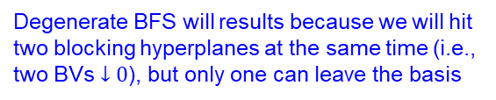

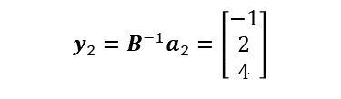
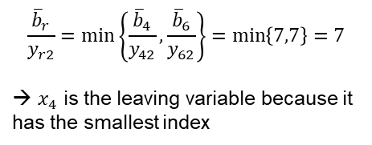
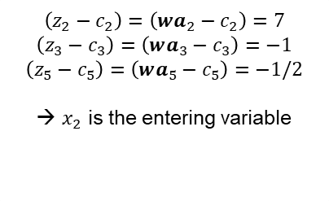
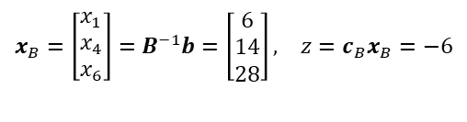
Simplex Algorithm with Bland’s Rule to Prevent Cycling (Iteration #2)
Step 1
$$\begin{matrix}min & −x_{1}−6x_{2}+x_{3} \\ s.t. & x_{1}+x_{2}+x_{3}+x_{4} =20 \\ & 2x_{1}−2x_{2} +x_{5} =12 \\ & 4x_{2}−2x_{3} +x_{6}=28 \\ & x_{1},x_{2},x_{3},x_{4},x_{5},x_{6}≥0\end{matrix}$$
$$\begin{matrix}x_{B}=\left[\begin{matrix}x_{1} \\ x_{4} \\ x_{6}\end{matrix}\right]=B^{−1}b=\left[\begin{matrix}6 \\ 14 \\ 28\end{matrix}\right], & z=c_{B}x_{B}=−6\end{matrix}$$
Note the ordering of basic variables; optionally ordinal here and necessarily so in all subsequence calculations
INITIALIZATION STEP. Choose a starting BFS with basis $B$.
MAIN STEP
Solve the system $Bx_{B}=b$ (with unique solution $x_{B}=B^{−1}b=\overline{b}$, $x_{N}=0$, and $z=c_{B}x_{B}$.
Solve the system $wB=c_{B}$ (with unique solution $w=c_{B}B^{−1}$) and conduct pricing, calculating $\left(z_{j}−c_{j}\right)=wa_{j}−c_{j}$ for all NBVs. Let $\left(z_{k}−c_{k}\right)=\max_{j∈J}\left\{z_{j}−c_{j}\right\}$. If $\left(z_{k}−c_{k}\right)≤0$, stop; current BFS is optimal. Otherwise, $x_{k}$ is the entering variable.
Solve the system $By_{k}=a_{k}$ (with unique solution $y_{k}=B^{−1}a_{k}$). If $y_{k}≤0$, stop; the solution is unbounded along the ray
$$d=\left\{\left[\begin{matrix}\overline{b} \\ 0\end{matrix}\right]+x_{k}\left[\begin{matrix}−y_{k} \\ e_{k}\end{matrix}\right],x_{k}≥0\right\}$$
Let $x_{k}$ enter the basis. Select the BV $x_{B_{i}}$ to leave the basis via the minimum ratio test
$$\frac{{\overline{b}}_{r}}{y_{rk}}=\min_{i=1,…,m}\left\{\frac{{\overline{b}}_{i}}{y_{ik}}:y_{ik}>0\right\}$$
Update the basis $B$ where $a_{k}$ replaces $a_{B_{i}}$, update the index set $J$, and repeat Step 1.
Step 2
$$\left(z_{2}−c_{2}\right)=\left(wa_{2}−c_{2}\right)=7$$
$$\left(z_{3}−c_{3}\right)=\left(wa_{3}−c_{3}\right)=−1$$
$$\left(z_{5}−c_{5}\right)=\left(wa_{5}−c_{5}\right)=−1/2$$
→ $x_{2}$ is the entering variable
Step 3
$$y_{2}=B^{−1}a_{2}=\left[\begin{matrix}−1 \\ 2 \\ 4\end{matrix}\right]$$
Step 4
$$\frac{{\overline{b}}_{r}}{y_{r2}}=\min\left\{\frac{{\overline{b}}_{4}}{y_{42}},\frac{{\overline{b}}_{6}}{y_{62}}\right\}=\min\left\{7,7\right\}=7$$
→ $x_{4}$ is the leaving variable because it has the smallest index
Degenerate BFS will results because we will hit two blocking hyperplanes at the same time (i.e., two BVs $↓0$), but only one can leave the basis

Slide 16
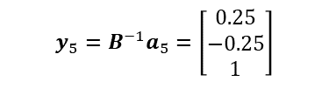

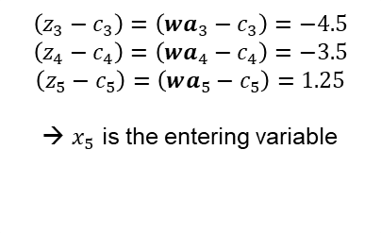
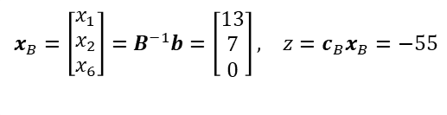
Simplex Algorithm with Bland’s Rule to Prevent Cycling (Iteration #3)
Step 1
$$\begin{matrix}min & −x_{1}−6x_{2}+x_{3} \\ s.t. & x_{1}+x_{2}+x_{3}+x_{4} =20 \\ & 2x_{1}−2x_{2} +x_{5} =12 \\ & 4x_{2}−2x_{3} +x_{6}=28 \\ & x_{1},x_{2},x_{3},x_{4},x_{5},x_{6}≥0\end{matrix}$$
$$\begin{matrix}x_{B}=\left[\begin{matrix}x_{1} \\ x_{2} \\ x_{6}\end{matrix}\right]=B^{−1}b=\left[\begin{matrix}13 \\ 7 \\ 0\end{matrix}\right], & z=c_{B}x_{B}=−55\end{matrix}$$
Note the ordering of basic variables; optionally ordinal here and necessarily so in all subsequence calculations
INITIALIZATION STEP. Choose a starting BFS with basis $B$.
MAIN STEP
Solve the system $Bx_{B}=b$ (with unique solution $x_{B}=B^{−1}b=\overline{b}$, $x_{N}=0$, and $z=c_{B}x_{B}$.
Solve the system $wB=c_{B}$ (with unique solution $w=c_{B}B^{−1}$) and conduct pricing, calculating $\left(z_{j}−c_{j}\right)=wa_{j}−c_{j}$ for all NBVs. Let $\left(z_{k}−c_{k}\right)=\max_{j∈J}\left\{z_{j}−c_{j}\right\}$. If $\left(z_{k}−c_{k}\right)≤0$, stop; current BFS is optimal. Otherwise, $x_{k}$ is the entering variable.
Solve the system $By_{k}=a_{k}$ (with unique solution $y_{k}=B^{−1}a_{k}$). If $y_{k}≤0$, stop; the solution is unbounded along the ray
$$d=\left\{\left[\begin{matrix}\overline{b} \\ 0\end{matrix}\right]+x_{k}\left[\begin{matrix}−y_{k} \\ e_{k}\end{matrix}\right],x_{k}≥0\right\}$$
Let $x_{k}$ enter the basis. Select the BV $x_{B_{i}}$ to leave the basis via the minimum ratio test
$$\frac{{\overline{b}}_{r}}{y_{rk}}=\min_{i=1,…,m}\left\{\frac{{\overline{b}}_{i}}{y_{ik}}:y_{ik}>0\right\}$$
Update the basis $B$ where $a_{k}$ replaces $a_{B_{i}}$, update the index set $J$, and repeat Step 1.
Step 2
$$\left(z_{3}−c_{3}\right)=\left(wa_{3}−c_{3}\right)=−4.5$$
$$\left(z_{4}−c_{4}\right)=\left(wa_{4}−c_{4}\right)=−3.5$$
$$\left(z_{5}−c_{5}\right)=\left(wa_{5}−c_{5}\right)=1.25$$
→ $x_{5}$ is the entering variable
Step 3
$$y_{5}=B^{−1}a_{5}=\left[\begin{matrix}0.25 \\ −0.25 \\ 1\end{matrix}\right]$$
Step 4
$$\frac{{\overline{b}}_{r}}{y_{r5}}=\min\left\{\frac{{\overline{b}}_{1}}{y_{15}},\frac{{\overline{b}}_{6}}{y_{65}}\right\}=\min\left\{52,0\right\}=0$$
→ $x_{6}$ is the leaving variable
A degenerate pivot from one BFS to a BFS located at the same EP.

Slide 17
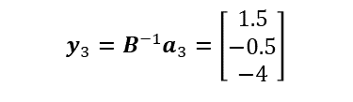
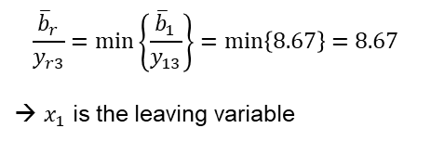
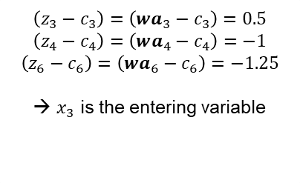

Simplex Algorithm with Bland’s Rule to Prevent Cycling (Iteration #4)
Step 1
$$\begin{matrix}min & −x_{1}−6x_{2}+x_{3} \\ s.t. & x_{1}+x_{2}+x_{3}+x_{4} =20 \\ & 2x_{1}−2x_{2} +x_{5} =12 \\ & 4x_{2}−2x_{3} +x_{6}=28 \\ & x_{1},x_{2},x_{3},x_{4},x_{5},x_{6}≥0\end{matrix}$$
$$\begin{matrix}x_{B}=\left[\begin{matrix}x_{1} \\ x_{2} \\ x_{5}\end{matrix}\right]=B^{−1}b=\left[\begin{matrix}13 \\ 7 \\ 0\end{matrix}\right], & z=c_{B}x_{B}=−55\end{matrix}$$
Note the ordering of basic variables; optionally ordinal here and necessarily so in all subsequence calculations
INITIALIZATION STEP. Choose a starting BFS with basis $B$.
MAIN STEP
Solve the system $Bx_{B}=b$ (with unique solution $x_{B}=B^{−1}b=\overline{b}$, $x_{N}=0$, and $z=c_{B}x_{B}$.
Solve the system $wB=c_{B}$ (with unique solution $w=c_{B}B^{−1}$) and conduct pricing, calculating $\left(z_{j}−c_{j}\right)=wa_{j}−c_{j}$ for all NBVs. Let $\left(z_{k}−c_{k}\right)=\max_{j∈J}\left\{z_{j}−c_{j}\right\}$. If $\left(z_{k}−c_{k}\right)≤0$, stop; current BFS is optimal. Otherwise, $x_{k}$ is the entering variable.
Solve the system $By_{k}=a_{k}$ (with unique solution $y_{k}=B^{−1}a_{k}$). If $y_{k}≤0$, stop; the solution is unbounded along the ray
$$d=\left\{\left[\begin{matrix}\overline{b} \\ 0\end{matrix}\right]+x_{k}\left[\begin{matrix}−y_{k} \\ e_{k}\end{matrix}\right],x_{k}≥0\right\}$$
Let $x_{k}$ enter the basis. Select the BV $x_{B_{i}}$ to leave the basis via the minimum ratio test
$$\frac{{\overline{b}}_{r}}{y_{rk}}=\min_{i=1,…,m}\left\{\frac{{\overline{b}}_{i}}{y_{ik}}:y_{ik}>0\right\}$$
Update the basis $B$ where $a_{k}$ replaces $a_{B_{i}}$, update the index set $J$, and repeat Step 1.
Step 2
$$\left(z_{3}−c_{3}\right)=\left(wa_{3}−c_{3}\right)=0.5$$
$$\left(z_{4}−c_{4}\right)=\left(wa_{4}−c_{4}\right)=−1$$
$$\left(z_{6}−c_{6}\right)=\left(wa_{6}−c_{6}\right)=−1.25$$
→ $x_{3}$ is the entering variable
Step 3
$$y_{3}=B^{−1}a_{3}=\left[\begin{matrix}1.5 \\ −0.5 \\ −4\end{matrix}\right]$$
Step 4
$$\frac{{\overline{b}}_{r}}{y_{r3}}=\min\left\{\frac{{\overline{b}}_{1}}{y_{13}}\right\}=\min\left\{8.67\right\}=8.67$$
→ $x_{1}$ is the leaving variable

Slide 18
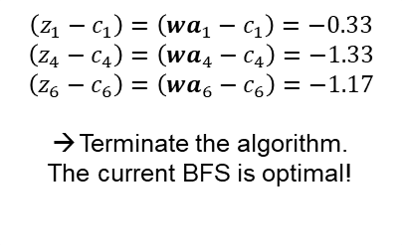
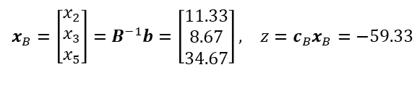
Simplex Algorithm with Bland’s Rule to Prevent Cycling (Iteration #5)
Step 1
$$\begin{matrix}min & −x_{1}−6x_{2}+x_{3} \\ s.t. & x_{1}+x_{2}+x_{3}+x_{4} =20 \\ & 2x_{1}−2x_{2} +x_{5} =12 \\ & 4x_{2}−2x_{3} +x_{6}=28 \\ & x_{1},x_{2},x_{3},x_{4},x_{5},x_{6}≥0\end{matrix}$$
$$\begin{matrix}x_{B}=\left[\begin{matrix}x_{2} \\ x_{3} \\ x_{5}\end{matrix}\right]=B^{−1}b=\left[\begin{matrix}11.33 \\ 8.67 \\ 34.67\end{matrix}\right], & z=c_{B}x_{B}=−59.33\end{matrix}$$
Note the ordering of basic variables; optionally ordinal here and necessarily so in all subsequence calculations
INITIALIZATION STEP. Choose a starting BFS with basis $B$.
MAIN STEP
Solve the system $Bx_{B}=b$ (with unique solution $x_{B}=B^{−1}b=\overline{b}$, $x_{N}=0$, and $z=c_{B}x_{B}$.
Solve the system $wB=c_{B}$ (with unique solution $w=c_{B}B^{−1}$) and conduct pricing, calculating $\left(z_{j}−c_{j}\right)=wa_{j}−c_{j}$ for all NBVs. Let $\left(z_{k}−c_{k}\right)=\max_{j∈J}\left\{z_{j}−c_{j}\right\}$. If $\left(z_{k}−c_{k}\right)≤0$, stop; current BFS is optimal. Otherwise, $x_{k}$ is the entering variable.
Solve the system $By_{k}=a_{k}$ (with unique solution $y_{k}=B^{−1}a_{k}$). If $y_{k}≤0$, stop; the solution is unbounded along the ray
$$d=\left\{\left[\begin{matrix}\overline{b} \\ 0\end{matrix}\right]+x_{k}\left[\begin{matrix}−y_{k} \\ e_{k}\end{matrix}\right],x_{k}≥0\right\}$$
Let $x_{k}$ enter the basis. Select the BV $x_{B_{i}}$ to leave the basis via the minimum ratio test
$$\frac{{\overline{b}}_{r}}{y_{rk}}=\min_{i=1,…,m}\left\{\frac{{\overline{b}}_{i}}{y_{ik}}:y_{ik}>0\right\}$$
Update the basis $B$ where $a_{k}$ replaces $a_{B_{i}}$, update the index set $J$, and repeat Step 1.
Step 2
$$\left(z_{1}−c_{1}\right)=\left(wa_{1}−c_{1}\right)=−0.33$$
$$\left(z_{4}−c_{4}\right)=\left(wa_{4}−c_{4}\right)=−1.33$$
$$\left(z_{6}−c_{6}\right)=\left(wa_{6}−c_{6}\right)=−1.17$$
Terminate the algorithm.
The current BFS is optimal!
Step 3
Step 4

Slide 19
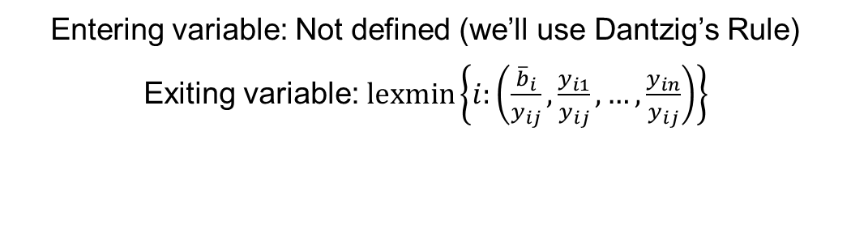
Cycling Prevention Rule #2: Lexicographic Rule
Entering variable: Not defined (we’ll use Dantzig’s Rule)
Exiting variable: $\operatorname{lexmin}\left\{i:\left(\frac{{\overline{b}}_{i}}{y_{ij}},\frac{y_{i1}}{y_{ij}},…,\frac{y_{in}}{y_{ij}}\right)\right\}$

Slide 20
Simplex Algorithm with the Lexicographic Rule to Prevent Cycling (Initialization)
Problem P
$$\begin{matrix}min & −x_{1}−6x_{2}+x_{3} \\ s.t. & x_{1}+x_{2}+x_{3}+x_{4} =20 \\ & 2x_{1}−2x_{2} +x_{5} =12 \\ & 4x_{2}−2x_{3} +x_{6}=28 \\ & x_{1},x_{2},x_{3},x_{4},x_{5},x_{6}≥0\end{matrix}$$
INTIALIZATION STEP
$$B=\left[\begin{matrix}a_{4} & a_{5} & a_{6}\end{matrix}\right]=\left[\begin{matrix}1 & 0 & 0 \\ 0 & 1 & 0 \\ 0 & 0 & 1\end{matrix}\right]$$
Degenerate EP

Slide 21


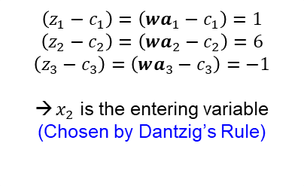
Simplex Algorithm with the Lexicographic Rule to Prevent Cycling (Iteration #1)
Step 1
$$\begin{matrix}min & −x_{1}−6x_{2}+x_{3} \\ s.t. & x_{1}+x_{2}+x_{3}+x_{4} =20 \\ & 2x_{1}−2x_{2} +x_{5} =12 \\ & 4x_{2}−2x_{3} +x_{6}=28 \\ & x_{1},x_{2},x_{3},x_{4},x_{5},x_{6}≥0\end{matrix}$$
$$\begin{matrix}B=\left[\begin{matrix}a_{4} & a_{5} & a_{6}\end{matrix}\right]=\left[\begin{matrix}1 & 0 & 0 \\ 0 & 1 & 0 \\ 0 & 0 & 1\end{matrix}\right] & & N=\left[\begin{matrix}a_{1} & a_{2} & a_{3}\end{matrix}\right]=\left[\begin{matrix}1 & 1 & 1 \\ 2 & −2 & 0 \\ 0 & 4 & −2\end{matrix}\right]\end{matrix}$$
$$\begin{matrix}x_{B}=\left[\begin{matrix}x_{4} \\ x_{5} \\ x_{6}\end{matrix}\right]=B^{−1}b=\left[\begin{matrix}20 \\ 12 \\ 28\end{matrix}\right], & x_{N}=\left[\begin{matrix}x_{1} \\ x_{2} \\ x_{3}\end{matrix}\right]=0, & z=c_{B}x_{B}=0\end{matrix}$$
INITIALIZATION STEP. Choose a starting BFS with basis $B$.
MAIN STEP
Solve the system $Bx_{B}=b$ (with unique solution $x_{B}=B^{−1}b=\overline{b}$, $x_{N}=0$, and $z=c_{B}x_{B}$.
Solve the system $wB=c_{B}$ (with unique solution $w=c_{B}B^{−1}$) and conduct pricing, calculating $\left(z_{j}−c_{j}\right)=wa_{j}−c_{j}$ for all NBVs. Let $\left(z_{k}−c_{k}\right)=\max_{j∈J}\left\{z_{j}−c_{j}\right\}$. If $\left(z_{k}−c_{k}\right)≤0$, stop; current BFS is optimal. Otherwise, $x_{k}$ is the entering variable.
Solve the system $By_{k}=a_{k}$ (with unique solution $y_{k}=B^{−1}a_{k}$). If $y_{k}≤0$, stop; the solution is unbounded along the ray
$$d=\left\{\left[\begin{matrix}\overline{b} \\ 0\end{matrix}\right]+x_{k}\left[\begin{matrix}−y_{k} \\ e_{k}\end{matrix}\right],x_{k}≥0\right\}$$
Let $x_{k}$ enter the basis. Select the BV $x_{B_{i}}$ to leave the basis via the minimum ratio test
$$\frac{{\overline{b}}_{r}}{y_{rk}}=\min_{i=1,…,m}\left\{\frac{{\overline{b}}_{i}}{y_{ik}}:y_{ik}>0\right\}$$
Update the basis $B$ where $a_{k}$ replaces $a_{B_{i}}$, update the index set $J$, and repeat Step 1.
Step 2
$$\left(z_{1}−c_{1}\right)=\left(wa_{1}−c_{1}\right)=1$$
$$\left(z_{2}−c_{2}\right)=\left(wa_{2}−c_{2}\right)=6$$
$$\left(z_{3}−c_{3}\right)=\left(wa_{3}−c_{3}\right)=−1$$
$x_{2}$ is the entering variable
(Chosen by Dantzig’s Rule)
Step 3
$$y_{2}=B^{−1}a_{2}=\left[\begin{matrix}1 \\ −2 \\ 4\end{matrix}\right]$$
Step 4
$$\frac{{\overline{b}}_{r}}{y_{r2}}=\min\left\{\frac{{\overline{b}}_{4}}{y_{42}},\frac{{\overline{b}}_{6}}{y_{62}}\right\}=\min\left\{20,7\right\}=7$$
→ $x_{6}$ is the leaving variable

Slide 22
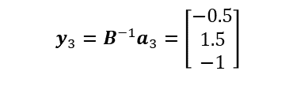


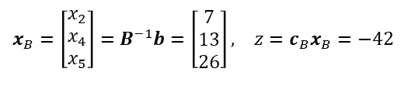
Simplex Algorithm with the Lexicographic Rule to Prevent Cycling (Iteration #2)
Step 1
$$\begin{matrix}min & −x_{1}−6x_{2}+x_{3} \\ s.t. & x_{1}+x_{2}+x_{3}+x_{4} =20 \\ & 2x_{1}−2x_{2} +x_{5} =12 \\ & 4x_{2}−2x_{3} +x_{6}=28 \\ & x_{1},x_{2},x_{3},x_{4},x_{5},x_{6}≥0\end{matrix}$$
$$\begin{matrix}x_{B}=\left[\begin{matrix}x_{2} \\ x_{4} \\ x_{5}\end{matrix}\right]=B^{−1}b=\left[\begin{matrix}7 \\ 13 \\ 26\end{matrix}\right], & z=c_{B}x_{B}=−42\end{matrix}$$
Note the ordering of basic variables; optionally ordinal here and necessarily so in all subsequence calculations
INITIALIZATION STEP. Choose a starting BFS with basis $B$.
MAIN STEP
Solve the system $Bx_{B}=b$ (with unique solution $x_{B}=B^{−1}b=\overline{b}$, $x_{N}=0$, and $z=c_{B}x_{B}$.
Solve the system $wB=c_{B}$ (with unique solution $w=c_{B}B^{−1}$) and conduct pricing, calculating $\left(z_{j}−c_{j}\right)=wa_{j}−c_{j}$ for all NBVs. Let $\left(z_{k}−c_{k}\right)=\max_{j∈J}\left\{z_{j}−c_{j}\right\}$. If $\left(z_{k}−c_{k}\right)≤0$, stop; current BFS is optimal. Otherwise, $x_{k}$ is the entering variable.
Solve the system $By_{k}=a_{k}$ (with unique solution $y_{k}=B^{−1}a_{k}$). If $y_{k}≤0$, stop; the solution is unbounded along the ray
$$d=\left\{\left[\begin{matrix}\overline{b} \\ 0\end{matrix}\right]+x_{k}\left[\begin{matrix}−y_{k} \\ e_{k}\end{matrix}\right],x_{k}≥0\right\}$$
Let $x_{k}$ enter the basis. Select the BV $x_{B_{i}}$ to leave the basis via the minimum ratio test
$$\frac{{\overline{b}}_{r}}{y_{rk}}=\min_{i=1,…,m}\left\{\frac{{\overline{b}}_{i}}{y_{ik}}:y_{ik}>0\right\}$$
Update the basis $B$ where $a_{k}$ replaces $a_{B_{i}}$, update the index set $J$, and repeat Step 1.
Step 2
$$\left(z_{1}−c_{1}\right)=\left(wa_{1}−c_{1}\right)=1$$
$$\left(z_{3}−c_{3}\right)=\left(wa_{3}−c_{3}\right)=2$$
$$\left(z_{6}−c_{6}\right)=\left(wa_{6}−c_{6}\right)=−1.5$$
$x_{3}$ is the entering variable
(Chosen by Dantzig’s Rule)
Step 3
$$y_{3}=B^{−1}a_{3}=\left[\begin{matrix}−0.5 \\ 1.5 \\ −1\end{matrix}\right]$$
Step 4
$$\frac{{\overline{b}}_{r}}{y_{r3}}=\min\left\{\frac{{\overline{b}}_{4}}{y_{43}}\right\}=\min\left\{8.67\right\}=8.67$$
→ $x_{4}$ is the leaving variable

Slide 23
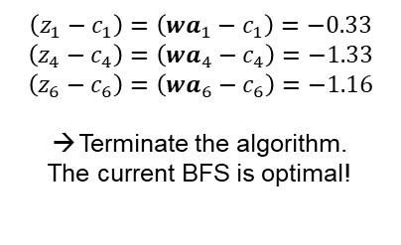
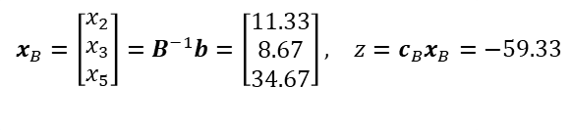
Simplex Algorithm with the Lexicographic Rule to Prevent Cycling (Iteration #3)
Step 1
$$\begin{matrix}min & −x_{1}−6x_{2}+x_{3} \\ s.t. & x_{1}+x_{2}+x_{3}+x_{4} =20 \\ & 2x_{1}−2x_{2} +x_{5} =12 \\ & 4x_{2}−2x_{3} +x_{6}=28 \\ & x_{1},x_{2},x_{3},x_{4},x_{5},x_{6}≥0\end{matrix}$$
$$\begin{matrix}x_{B}=\left[\begin{matrix}x_{2} \\ x_{3} \\ x_{5}\end{matrix}\right]=B^{−1}b=\left[\begin{matrix}11.33 \\ 8.67 \\ 34.67\end{matrix}\right], & z=c_{B}x_{B}=−59.33\end{matrix}$$
Note the ordering of basic variables; optionally ordinal here and necessarily so in all subsequence calculations
INITIALIZATION STEP. Choose a starting BFS with basis $B$.
MAIN STEP
Solve the system $Bx_{B}=b$ (with unique solution $x_{B}=B^{−1}b=\overline{b}$, $x_{N}=0$, and $z=c_{B}x_{B}$.
Solve the system $wB=c_{B}$ (with unique solution $w=c_{B}B^{−1}$) and conduct pricing, calculating $\left(z_{j}−c_{j}\right)=wa_{j}−c_{j}$ for all NBVs. Let $\left(z_{k}−c_{k}\right)=\max_{j∈J}\left\{z_{j}−c_{j}\right\}$. If $\left(z_{k}−c_{k}\right)≤0$, stop; current BFS is optimal. Otherwise, $x_{k}$ is the entering variable.
Solve the system $By_{k}=a_{k}$ (with unique solution $y_{k}=B^{−1}a_{k}$). If $y_{k}≤0$, stop; the solution is unbounded along the ray
$$d=\left\{\left[\begin{matrix}\overline{b} \\ 0\end{matrix}\right]+x_{k}\left[\begin{matrix}−y_{k} \\ e_{k}\end{matrix}\right],x_{k}≥0\right\}$$
Let $x_{k}$ enter the basis. Select the BV $x_{B_{i}}$ to leave the basis via the minimum ratio test
$$\frac{{\overline{b}}_{r}}{y_{rk}}=\min_{i=1,…,m}\left\{\frac{{\overline{b}}_{i}}{y_{ik}}:y_{ik}>0\right\}$$
Update the basis $B$ where $a_{k}$ replaces $a_{B_{i}}$, update the index set $J$, and repeat Step 1.
Step 2
$$\left(z_{1}−c_{1}\right)=\left(wa_{1}−c_{1}\right)=−0.33$$
$$\left(z_{4}−c_{4}\right)=\left(wa_{4}−c_{4}\right)=−1.33$$
$$\left(z_{6}−c_{6}\right)=\left(wa_{6}−c_{6}\right)=−1.16$$
Terminate the algorithm.
The current BFS is optimal!
Step 3
Step 4

Slide 24
Bland’s v. Lexicographic Different Simplex Paths for same Initial BFS
Bland’s Rule
Lexicographic Rule
Degenerate Pivot
But how would the Lexicographic Method handle the degenerate extreme point if it encountered it?

Slide 25
Cycling Prevention Rule #2: Lexicographic Rule
Entering variable: Not defined (we’ll use Dantzig’s Rule)
Exiting variable: $\operatorname{lexmin}\left\{i:\left(\frac{{\overline{b}}_{i}}{y_{ij}},\frac{y_{i1}}{y_{ij}},…,\frac{y_{in}}{y_{ij}}\right)\right\}$
(With a different Initial BFS to demonstrate its implementation on a degenerate pivot)

Slide 26
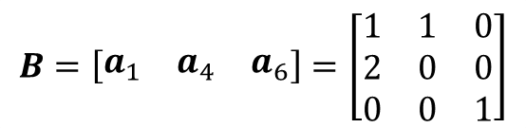
Simplex Algorithm with the Lexicographic Rule to Prevent Cycling (Initialization)
Problem P
$$\begin{matrix}min & −x_{1}−6x_{2}+x_{3} \\ s.t. & x_{1}+x_{2}+x_{3}+x_{4} =20 \\ & 2x_{1}−2x_{2} +x_{5} =12 \\ & 4x_{2}−2x_{3} +x_{6}=28 \\ & x_{1},x_{2},x_{3},x_{4},x_{5},x_{6}≥0\end{matrix}$$
Initial
BFS
INTIALIZATION STEP
$$B=\left[\begin{matrix}a_{1} & a_{4} & a_{6}\end{matrix}\right]=\left[\begin{matrix}1 & 1 & 0 \\ 2 & 0 & 0 \\ 0 & 0 & 1\end{matrix}\right]$$
Degenerate EP

Slide 27
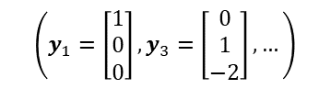
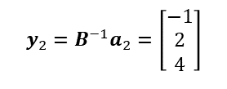
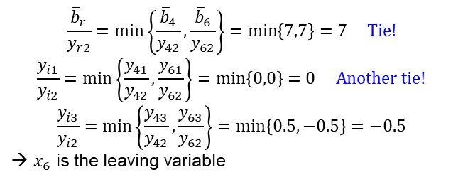
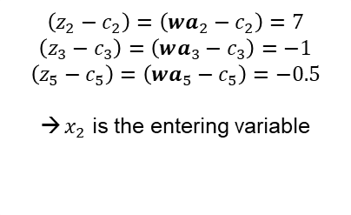
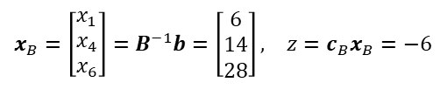

Simplex Algorithm with the Lexicographic Rule to Prevent Cycling (Iteration #1)
Step 1
$$\begin{matrix}min & −x_{1}−6x_{2}+x_{3} \\ s.t. & x_{1}+x_{2}+x_{3}+x_{4} =20 \\ & 2x_{1}−2x_{2} +x_{5} =12 \\ & 4x_{2}−2x_{3} +x_{6}=28 \\ & x_{1},x_{2},x_{3},x_{4},x_{5},x_{6}≥0\end{matrix}$$
$$\begin{matrix}x_{B}=\left[\begin{matrix}x_{1} \\ x_{4} \\ x_{6}\end{matrix}\right]=B^{−1}b=\left[\begin{matrix}6 \\ 14 \\ 28\end{matrix}\right], & z=c_{B}x_{B}=−6\end{matrix}$$
INITIALIZATION STEP. Choose a starting BFS with basis $B$.
MAIN STEP
Solve the system $Bx_{B}=b$ (with unique solution $x_{B}=B^{−1}b=\overline{b}$, $x_{N}=0$, and $z=c_{B}x_{B}$.
Solve the system $wB=c_{B}$ (with unique solution $w=c_{B}B^{−1}$) and conduct pricing, calculating $\left(z_{j}−c_{j}\right)=wa_{j}−c_{j}$ for all NBVs. Let $\left(z_{k}−c_{k}\right)=\max_{j∈J}\left\{z_{j}−c_{j}\right\}$. If $\left(z_{k}−c_{k}\right)≤0$, stop; current BFS is optimal. Otherwise, $x_{k}$ is the entering variable.
Solve the system $By_{k}=a_{k}$ (with unique solution $y_{k}=B^{−1}a_{k}$). If $y_{k}≤0$, stop; the solution is unbounded along the ray
$$d=\left\{\left[\begin{matrix}\overline{b} \\ 0\end{matrix}\right]+x_{k}\left[\begin{matrix}−y_{k} \\ e_{k}\end{matrix}\right],x_{k}≥0\right\}$$
Let $x_{k}$ enter the basis. Select the BV $x_{B_{i}}$ to leave the basis via the minimum ratio test
$$\frac{{\overline{b}}_{r}}{y_{rk}}=\min_{i=1,…,m}\left\{\frac{{\overline{b}}_{i}}{y_{ik}}:y_{ik}>0\right\}$$
Update the basis $B$ where $a_{k}$ replaces $a_{B_{i}}$, update the index set $J$, and repeat Step 1.
Step 2
$$\left(z_{2}−c_{2}\right)=\left(wa_{2}−c_{2}\right)=7$$
$$\left(z_{3}−c_{3}\right)=\left(wa_{3}−c_{3}\right)=−1$$
$$\left(z_{5}−c_{5}\right)=\left(wa_{5}−c_{5}\right)=−0.5$$
$x_{2}$ is the entering variable
Step 3
$$y_{2}=B^{−1}a_{2}=\left[\begin{matrix}−1 \\ 2 \\ 4\end{matrix}\right]$$
$$\left(y_{1}=\left[\begin{matrix}1 \\ 0 \\ 0\end{matrix}\right],y_{3}=\left[\begin{matrix}0 \\ 1 \\ −2\end{matrix}\right],…\right)$$
Step 4
$$\frac{{\overline{b}}_{r}}{y_{r2}}=\min\left\{\frac{{\overline{b}}_{4}}{y_{42}},\frac{{\overline{b}}_{6}}{y_{62}}\right\}=\min\left\{7,7\right\}=7 Tie!$$
$$\frac{y_{i1}}{y_{i2}}=\min\left\{\frac{y_{41}}{y_{42}},\frac{y_{61}}{y_{62}}\right\}=\min\left\{0,0\right\}=0 Another tie!$$
$$\frac{y_{i3}}{y_{i2}}=\min\left\{\frac{y_{43}}{y_{42}},\frac{y_{63}}{y_{62}}\right\}=\min\left\{0.5,−0.5\right\}=−0.5$$
→ $x_{6}$ is the leaving variable
Degenerate BFS will results because we will hit two blocking hyperplanes at the same time (i.e., two BVs $↓0$), but only one can leave the basis
We’ll always eventually break the tie. Why?
Why can we consider $y_{63}<0$?

Slide 28
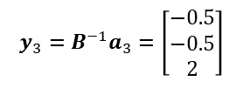



Simplex Algorithm with the Lexicographic Rule to Prevent Cycling (Iteration #2)
Step 1
$$\begin{matrix}min & −x_{1}−6x_{2}+x_{3} \\ s.t. & x_{1}+x_{2}+x_{3}+x_{4} =20 \\ & 2x_{1}−2x_{2} +x_{5} =12 \\ & 4x_{2}−2x_{3} +x_{6}=28 \\ & x_{1},x_{2},x_{3},x_{4},x_{5},x_{6}≥0\end{matrix}$$
$$\begin{matrix}x_{B}=\left[\begin{matrix}x_{1} \\ x_{2} \\ x_{4}\end{matrix}\right]=B^{−1}b=\left[\begin{matrix}13 \\ 7 \\ 0\end{matrix}\right], & z=c_{B}x_{B}=−55\end{matrix}$$
INITIALIZATION STEP. Choose a starting BFS with basis $B$.
MAIN STEP
Solve the system $Bx_{B}=b$ (with unique solution $x_{B}=B^{−1}b=\overline{b}$, $x_{N}=0$, and $z=c_{B}x_{B}$.
Solve the system $wB=c_{B}$ (with unique solution $w=c_{B}B^{−1}$) and conduct pricing, calculating $\left(z_{j}−c_{j}\right)=wa_{j}−c_{j}$ for all NBVs. Let $\left(z_{k}−c_{k}\right)=\max_{j∈J}\left\{z_{j}−c_{j}\right\}$. If $\left(z_{k}−c_{k}\right)≤0$, stop; current BFS is optimal. Otherwise, $x_{k}$ is the entering variable.
Solve the system $By_{k}=a_{k}$ (with unique solution $y_{k}=B^{−1}a_{k}$). If $y_{k}≤0$, stop; the solution is unbounded along the ray
$$d=\left\{\left[\begin{matrix}\overline{b} \\ 0\end{matrix}\right]+x_{k}\left[\begin{matrix}−y_{k} \\ e_{k}\end{matrix}\right],x_{k}≥0\right\}$$
Let $x_{k}$ enter the basis. Select the BV $x_{B_{i}}$ to leave the basis via the minimum ratio test
$$\frac{{\overline{b}}_{r}}{y_{rk}}=\min_{i=1,…,m}\left\{\frac{{\overline{b}}_{i}}{y_{ik}}:y_{ik}>0\right\}$$
Update the basis $B$ where $a_{k}$ replaces $a_{B_{i}}$, update the index set $J$, and repeat Step 1.
Step 2
$$\left(z_{3}−c_{3}\right)=\left(wa_{3}−c_{3}\right)=2.5$$
$$\left(z_{5}−c_{5}\right)=\left(wa_{5}−c_{5}\right)=−0.5$$
$$\left(z_{6}−c_{6}\right)=\left(wa_{6}−c_{6}\right)=−1.75$$
$x_{3}$ is the entering variable
Step 3
$$y_{3}=B^{−1}a_{3}=\left[\begin{matrix}−0.5 \\ −0.5 \\ 2\end{matrix}\right]$$
Step 4
$$\frac{{\overline{b}}_{r}}{y_{r3}}=\min\left\{\frac{{\overline{b}}_{4}}{y_{43}}\right\}=\min\left\{0\right\}=0$$
→ $x_{4}$ is the leaving variable
A degenerate pivot from one BFS to a BFS located at the same EP.

Slide 29




Simplex Algorithm with the Lexicographic Rule to Prevent Cycling (Iteration #3)
Step 1
$$\begin{matrix}min & −x_{1}−6x_{2}+x_{3} \\ s.t. & x_{1}+x_{2}+x_{3}+x_{4} =20 \\ & 2x_{1}−2x_{2} +x_{5} =12 \\ & 4x_{2}−2x_{3} +x_{6}=28 \\ & x_{1},x_{2},x_{3},x_{4},x_{5},x_{6}≥0\end{matrix}$$
$$\begin{matrix}x_{B}=\left[\begin{matrix}x_{1} \\ x_{2} \\ x_{3}\end{matrix}\right]=B^{−1}b=\left[\begin{matrix}13 \\ 7 \\ 0\end{matrix}\right], & z=c_{B}x_{B}=−55\end{matrix}$$
INITIALIZATION STEP. Choose a starting BFS with basis $B$.
MAIN STEP
Solve the system $Bx_{B}=b$ (with unique solution $x_{B}=B^{−1}b=\overline{b}$, $x_{N}=0$, and $z=c_{B}x_{B}$.
Solve the system $wB=c_{B}$ (with unique solution $w=c_{B}B^{−1}$) and conduct pricing, calculating $\left(z_{j}−c_{j}\right)=wa_{j}−c_{j}$ for all NBVs. Let $\left(z_{k}−c_{k}\right)=\max_{j∈J}\left\{z_{j}−c_{j}\right\}$. If $\left(z_{k}−c_{k}\right)≤0$, stop; current BFS is optimal. Otherwise, $x_{k}$ is the entering variable.
Solve the system $By_{k}=a_{k}$ (with unique solution $y_{k}=B^{−1}a_{k}$). If $y_{k}≤0$, stop; the solution is unbounded along the ray
$$d=\left\{\left[\begin{matrix}\overline{b} \\ 0\end{matrix}\right]+x_{k}\left[\begin{matrix}−y_{k} \\ e_{k}\end{matrix}\right],x_{k}≥0\right\}$$
Let $x_{k}$ enter the basis. Select the BV $x_{B_{i}}$ to leave the basis via the minimum ratio test
$$\frac{{\overline{b}}_{r}}{y_{rk}}=\min_{i=1,…,m}\left\{\frac{{\overline{b}}_{i}}{y_{ik}}:y_{ik}>0\right\}$$
Update the basis $B$ where $a_{k}$ replaces $a_{B_{i}}$, update the index set $J$, and repeat Step 1.
Step 2
$$\left(z_{4}−c_{4}\right)=\left(wa_{4}−c_{4}\right)=−1.25$$
$$\left(z_{5}−c_{5}\right)=\left(wa_{5}−c_{5}\right)=0.125$$
$$\left(z_{6}−c_{6}\right)=\left(wa_{6}−c_{6}\right)=−1.125$$
$x_{5}$ is the entering variable
Step 3
$$y_{5}=B^{−1}a_{5}=\left[\begin{matrix}0.375 \\ −0.125 \\ −0.25\end{matrix}\right]$$
Step 4
$$\frac{{\overline{b}}_{r}}{y_{r5}}=\min\left\{\frac{{\overline{b}}_{1}}{y_{15}}\right\}=\min\left\{34.67\right\}=34.67$$
→ $x_{1}$ is the leaving variable

Slide 30

Simplex Algorithm with the Lexicographic Rule to Prevent Cycling (Iteration #4)
Step 1
$$\begin{matrix}min & −x_{1}−6x_{2}+x_{3} \\ s.t. & x_{1}+x_{2}+x_{3}+x_{4} =20 \\ & 2x_{1}−2x_{2} +x_{5} =12 \\ & 4x_{2}−2x_{3} +x_{6}=28 \\ & x_{1},x_{2},x_{3},x_{4},x_{5},x_{6}≥0\end{matrix}$$
$$\begin{matrix}x_{B}=\left[\begin{matrix}x_{2} \\ x_{3} \\ x_{5}\end{matrix}\right]=B^{−1}b=\left[\begin{matrix}11.33 \\ 8.67 \\ 34.67\end{matrix}\right], & z=c_{B}x_{B}=−59.33\end{matrix}$$
Note the ordering of basic variables; optionally ordinal here and necessarily so in all subsequence calculations
INITIALIZATION STEP. Choose a starting BFS with basis $B$.
MAIN STEP
Solve the system $Bx_{B}=b$ (with unique solution $x_{B}=B^{−1}b=\overline{b}$, $x_{N}=0$, and $z=c_{B}x_{B}$.
Solve the system $wB=c_{B}$ (with unique solution $w=c_{B}B^{−1}$) and conduct pricing, calculating $\left(z_{j}−c_{j}\right)=wa_{j}−c_{j}$ for all NBVs. Let $\left(z_{k}−c_{k}\right)=\max_{j∈J}\left\{z_{j}−c_{j}\right\}$. If $\left(z_{k}−c_{k}\right)≤0$, stop; current BFS is optimal. Otherwise, $x_{k}$ is the entering variable.
Solve the system $By_{k}=a_{k}$ (with unique solution $y_{k}=B^{−1}a_{k}$). If $y_{k}≤0$, stop; the solution is unbounded along the ray
$$d=\left\{\left[\begin{matrix}\overline{b} \\ 0\end{matrix}\right]+x_{k}\left[\begin{matrix}−y_{k} \\ e_{k}\end{matrix}\right],x_{k}≥0\right\}$$
Let $x_{k}$ enter the basis. Select the BV $x_{B_{i}}$ to leave the basis via the minimum ratio test
$$\frac{{\overline{b}}_{r}}{y_{rk}}=\min_{i=1,…,m}\left\{\frac{{\overline{b}}_{i}}{y_{ik}}:y_{ik}>0\right\}$$
Update the basis $B$ where $a_{k}$ replaces $a_{B_{i}}$, update the index set $J$, and repeat Step 1.
Step 2
$$\left(z_{1}−c_{1}\right)=\left(wa_{1}−c_{1}\right)=−0.33$$
$$\left(z_{4}−c_{4}\right)=\left(wa_{4}−c_{4}\right)=−1.33$$
$$\left(z_{6}−c_{6}\right)=\left(wa_{6}−c_{6}\right)=−1.16$$
Terminate the algorithm.
The current BFS is optimal!
Step 3
Step 4
Degenerate Pivot

Slide 31
Questions & Discussion

Slide 32
For Next Class
Section 5.3: Farka’s Lemma
Homework #6:
Problem 3.5
Algebraic method only; the tableau implementation will not receive credit
Software authorized if it’s your coding and you include a printout
Problem 3.49 – best puzzle (with a purpose) ever!

